Slide 1



Be SMART, Save I/O: Probabilistic Approach to Avoid Uncorrectable Errors in Storage Systems
Md Arifuzzaman, Masudul Bhuiyan, Mehmet Gumus, and Engin Arslan
University of Nevada, Reno, CISPA Helmholtz Center for Information Security

Slide 2
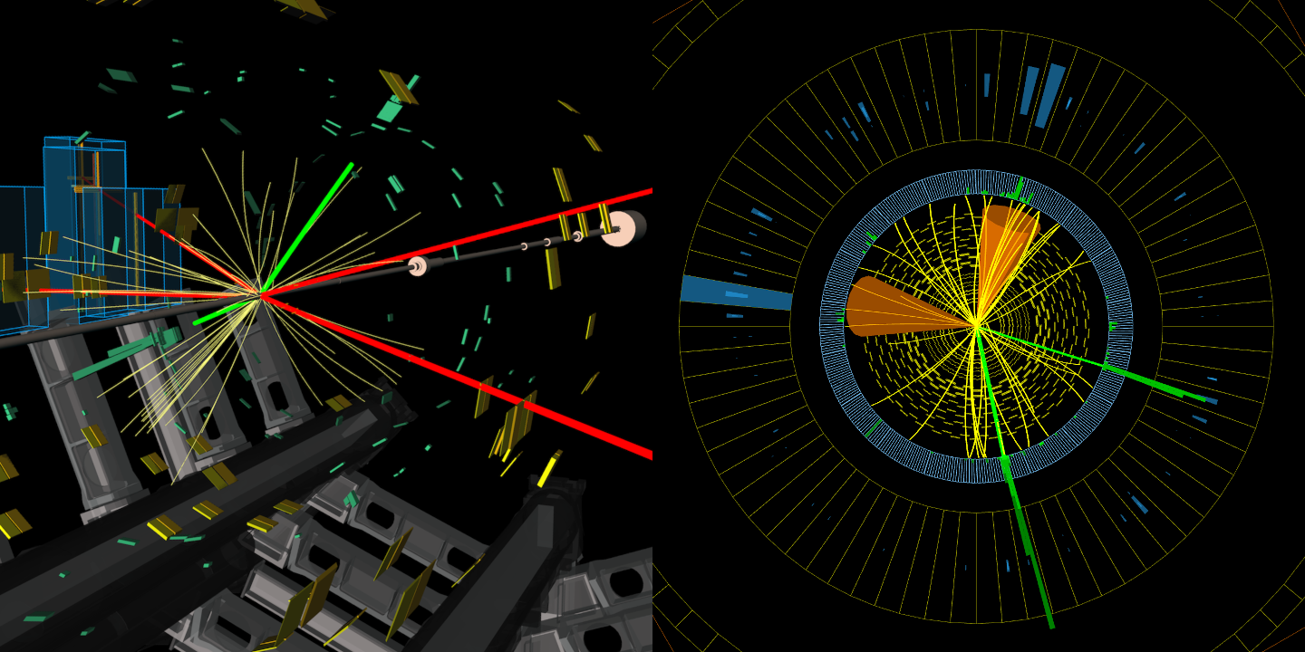
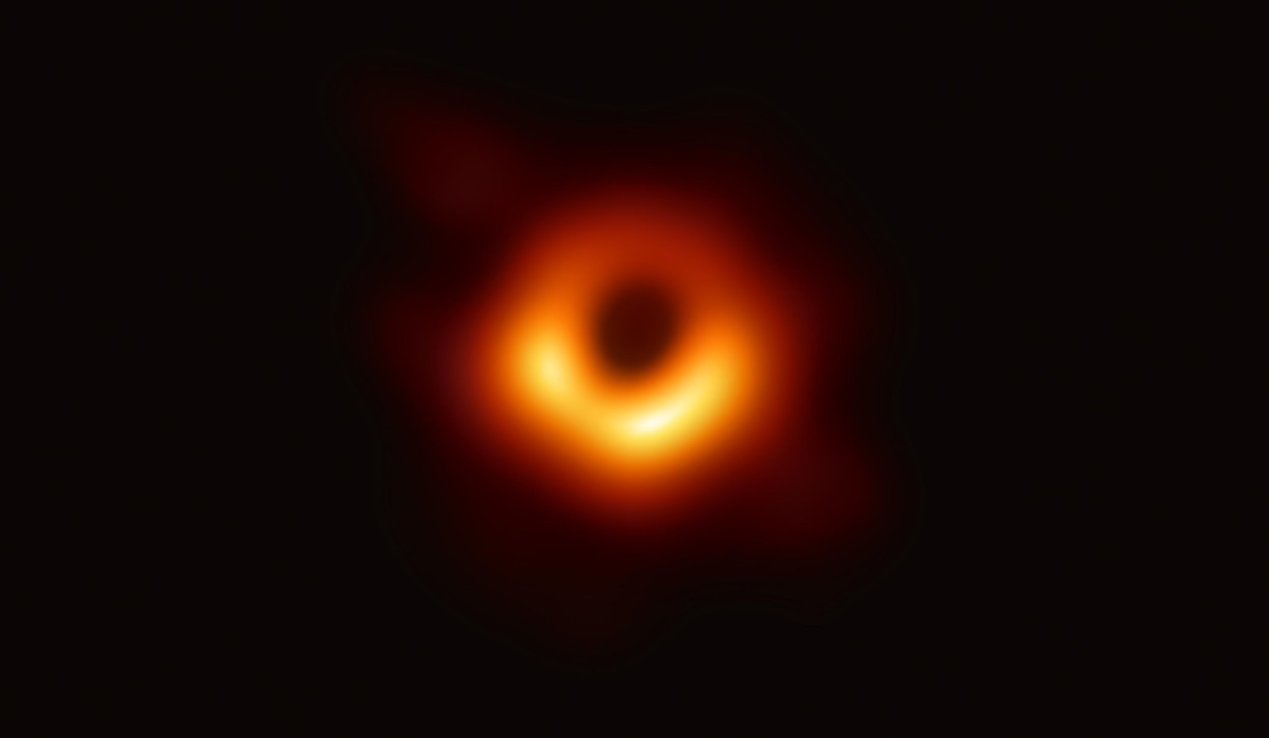
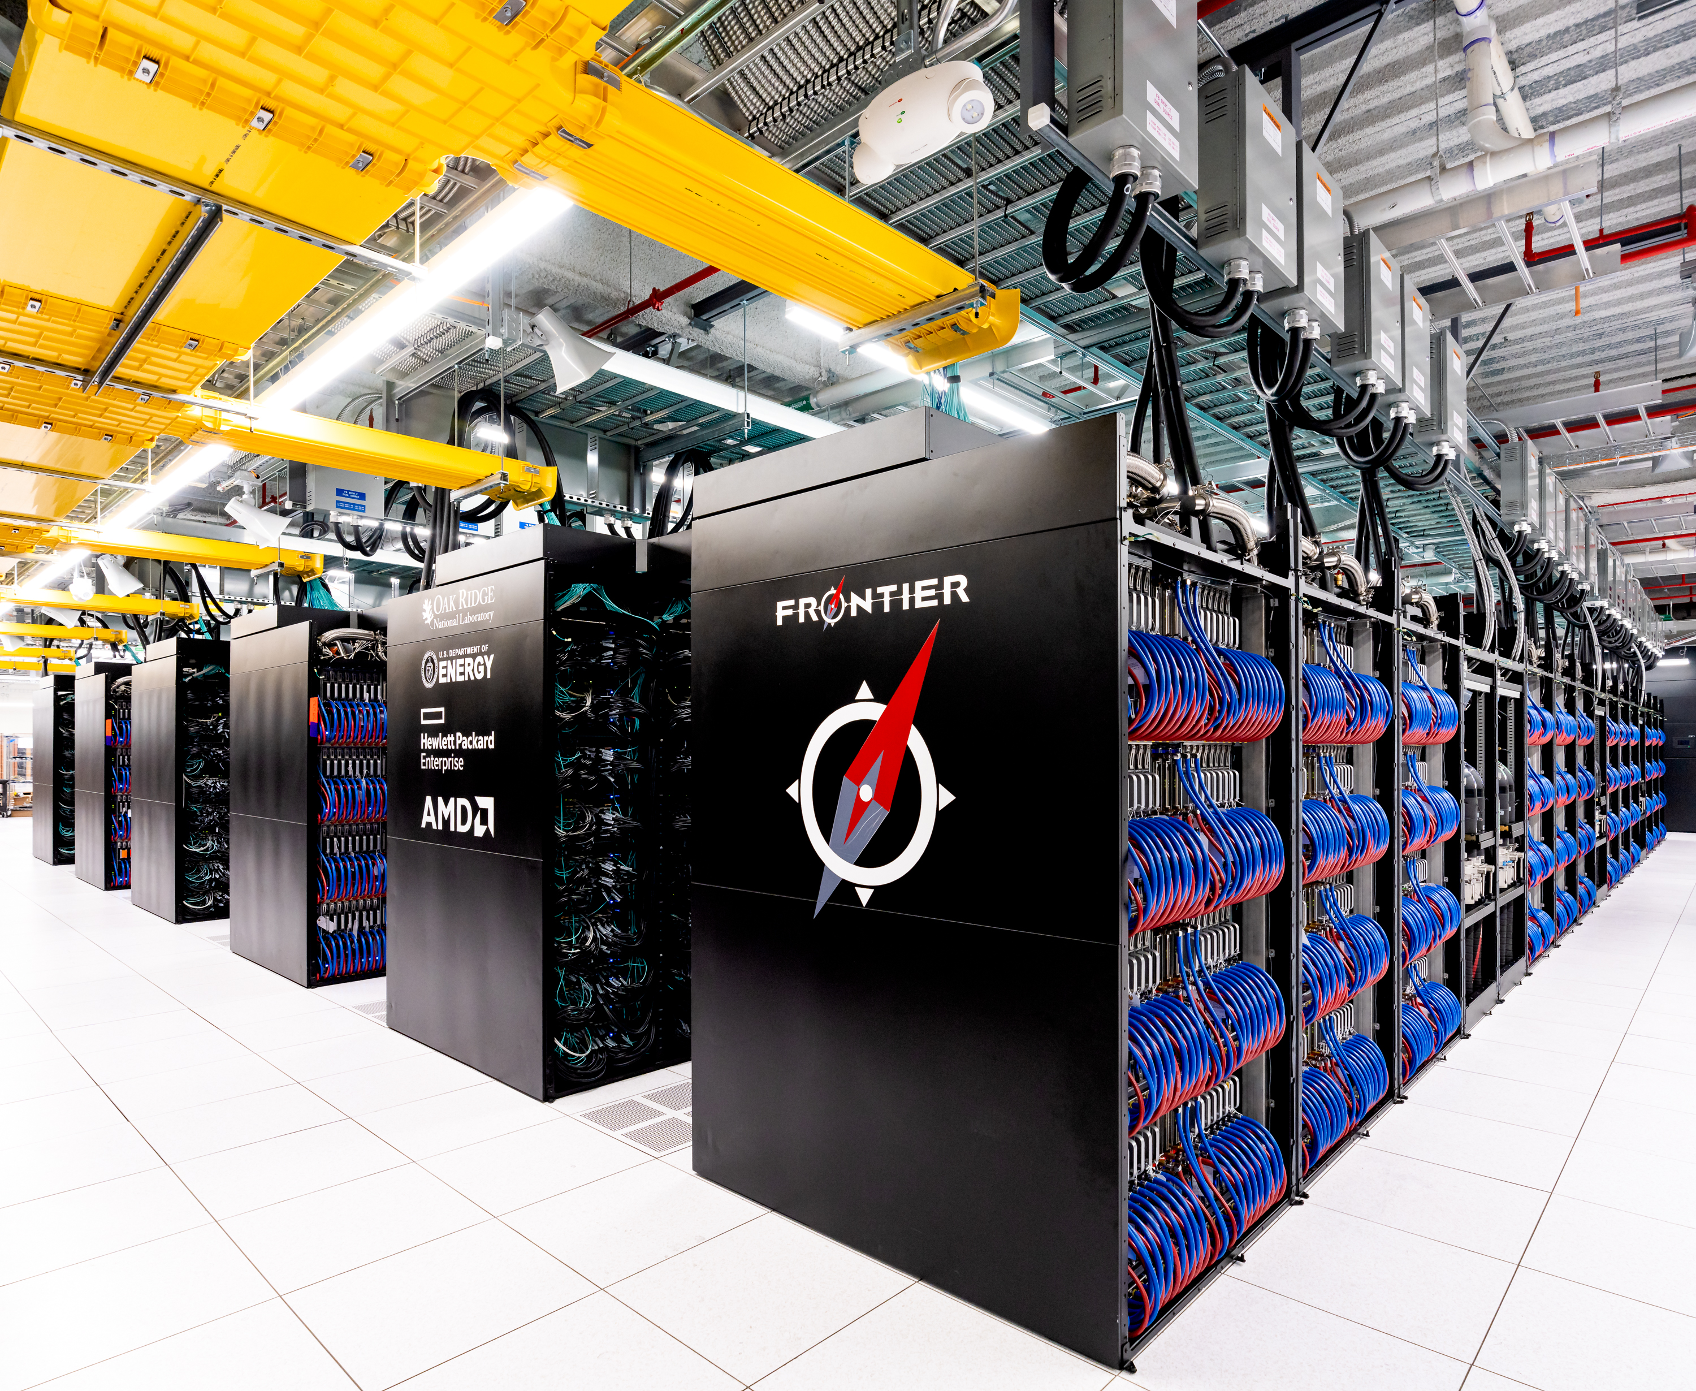
Big Data of Science
Large Hadron Collider (LHC) experiment at CERN produces more than 120 PB of data per year.
Event Horizon Telescopes produce 4.5 petabytes of astronomy data every day.
Storages capacity of Frontier supercomputer is around 700 petabyte.

Slide 3
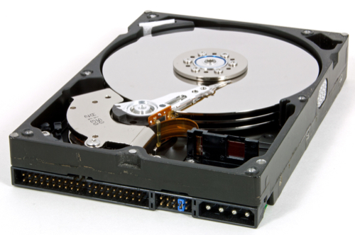
Error is Inevitable
Hard drives use Error Correcting Code (ECC) to detect and recover from errors.
Yes, a non-negligible portion of errors skips ECC, ﻿referred to as Uncorrectable Errors (UE)
﻿Uncorrectable errors take place once in every 10¹² (125GB) to 10¹⁵ (125TB) bits of I/O operation.
20-57% of disks in Google and Facebook data centers experienced one UE in their lifetime.

Slide 4
Failure is Costly
Uncorrectable errors can lead to data loss, disk failure, or even service interruption.
According to Gartner, server downtime costs $5,600 per minute on average.
The average cost of a data center outage is $740,357.

Slide 5
Problem Statement
Can we predict uncorrectable errors before they happen?
Almost!

Slide 6
SMART Values
SMART (Self-Monitoring, Analysis and Reporting Technology) is a monitoring system
It is supported by most disk drives.
It provides various indicators of drive health.
It reports various types of disk errors such as Seek Error Rate, Read Error Rate, and Uncorrectable Error.
It also reports operational data, such as drive temperature, and power on hours of the drive.
SMART logs are typically populated once a day for each disk.

Slide 7
﻿Dataset
﻿February 2014 to September 2021 (93 months)
﻿270M SMART logs.
﻿200K unique disks in total but 30K-120K of them were active at any given day.
﻿9.25K disks had ﻿at least one uncorrectable error (error percentage ﻿8.7%)
5% of disks had 89% of all errors and less than 10% of disks had 92.4% of all errors.
Notes:
﻿5% of disks had 89% of all errors and less than 10% of disks had 92:4% of all errors.

Slide 8
SMART Attributes
ID | Attribute Name | Importance Score
7 | ﻿Seek Error Rate | ﻿0.1711
9 | ﻿Power-On Hours | ﻿0.1633
1 | ﻿Read Error Rate | ﻿0.1346
193 | ﻿Load Cycle Count | 0.1208
187 | ﻿Uncorrectable Error | ﻿0.1176

Slide 9
﻿Performance Comparison Of Machine Learning Models
Drive Models | CNN-LSTM | DNN | DT | SVC | RF | RF | XGB
ST12000NM0007 | 95.41 | 96.9 | 90.4 | 97.93 | 97.85 | 98.19 | 98.25
ST4000DM000 | 93.79 | 94.17 | 81.68 | 93.98 | 93.81 | 94.45 | 94.7
ST8000NM0055 | 90.08 | 91.82 | 81.94 | 94.81 | 94.32 | 94.87 | 95.57
ST8000DM002 | 92.2 | 93.85 | 83.9 | 95.87 | 95.17 | 95.47 | 96.05
ST3000DM001 | 88.13 | 91.3 | 76.8 | 88.71 | 91.83 | 92.63 | 91.78
Models | CNN-LSTM | DNN | DT | SVC | RF | RF | XGB
ST12000NM0007 | 95.41 | 96.9 | 90.4 | 97.93 | 97.85 | 98.19 | 98.25
ST4000DM000 | 93.79 | 94.17 | 81.68 | 93.98 | 93.81 | 94.45 | 94.7
ST8000NM0055 | 90.08 | 91.82 | 81.94 | 94.81 | 94.32 | 94.87 | 95.57
ST8000DM002 | 92.2 | 93.85 | 83.9 | 95.87 | 95.17 | 95.47 | 96.05
ST3000DM001 | 88.13 | 91.3 | 76.8 | 88.71 | 91.83 | 92.63 | 91.78
Previous proposed Model
Neural network models

Slide 10
Application Scenarios to Utilize the Predictability of Uncorrectable Errors

Slide 11





End-to-End File Transfer
Sender
Receiver
Disk
Memory
Memory
Disk
Network
﻿Uncorrectable error

Slide 12
End-to-End Integrity Verification​​​
Sender
Receiver
Disk
Memory
Memory
Disk
Network
2367213558
2367213558

Slide 13
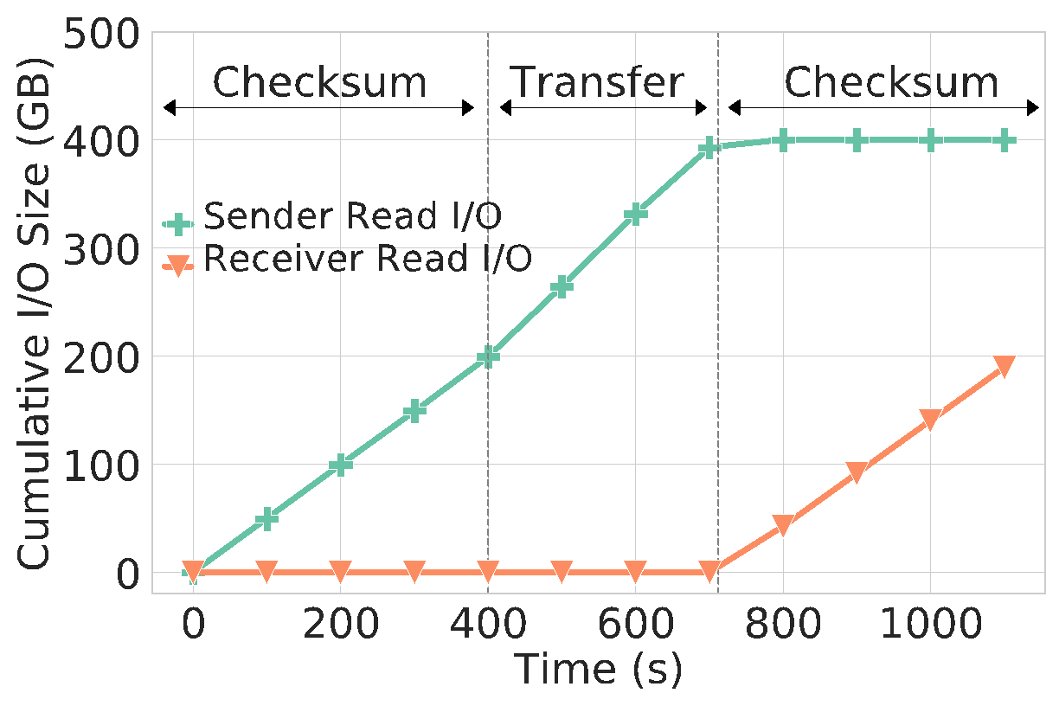
Additional I/O Size for End-to-End Integrity Verification​​​
Additional I/O in sender
200 GB
Additional I/O in
receiver
200 GB

Slide 14
Impact of Integrity Verification on Transfer Time
487s for Checksum Computation
400s for Checksum Computation
Actual Transfer Time=312s

Slide 15


Slide 16
Probabilistic Integrity Verification

Slide 17




Probabilistic Integrity Verification
Disk 1
Memory
Disk 2
Disk 3
Disk 4

Slide 18



Probabilistic Integrity Verification
Disk 1
p=0.05
Memory
ML Model
Disk 2
p=0.02
Disk 3
p=0.6
Disk 4
p=0.9

Slide 19
Probabilistic Integrity Verification
Disk 1
p=0.05
Memory
ML Model
Disk 2
No Error
p=0.02
Disk 3
p=0.6
Disk 4
p=0.9

Slide 20
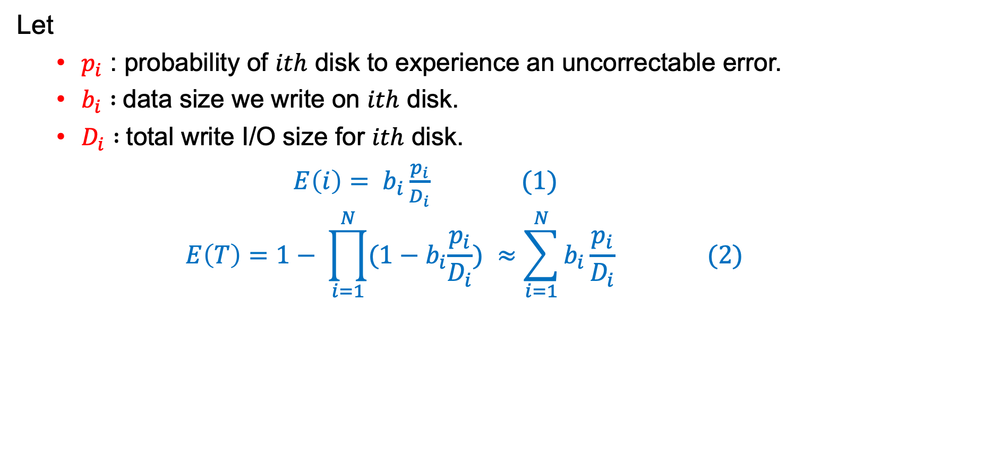
﻿Problem Definition

Slide 21

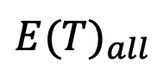


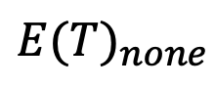
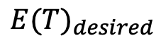
Disk 1
Disk 1
Disk 1
X
Disk 2
Disk 2
Disk 2
X
X
Probabilistic Integrity Verification aims to select disks to run integrity verification such that most errors captured by checking fewer disks possible
Disk 3
Disk 3
Disk 3
X
X
Disk 4
Disk 4
Disk 4
X
$${E(T)}_{desired}$$
No I/O overhead
Fast transfers
Fails to capture errors
Captures all errors
Incurs high I/O overhead
Slow transfer speed
Low I/O overhead
Fast transfers
Captures most errors

Slide 22
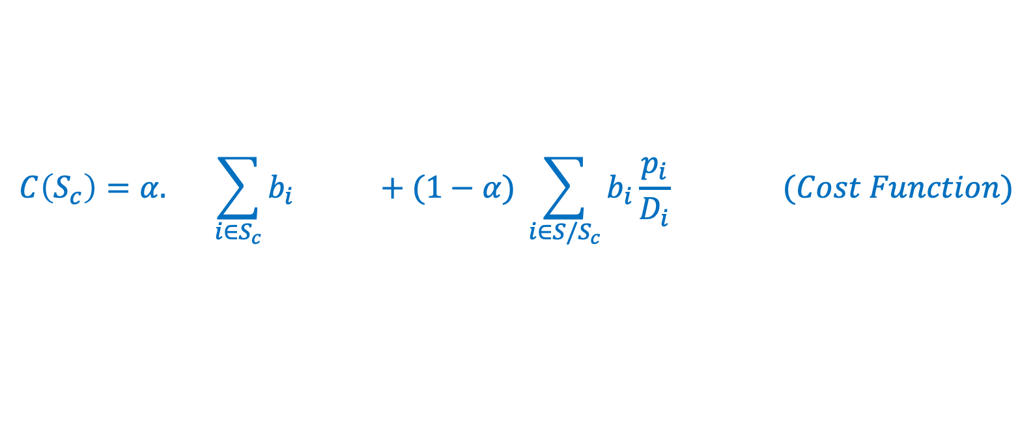
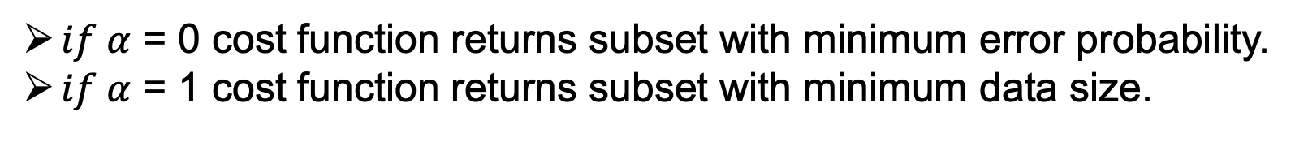
﻿Problem Definition
Total data size on which we run integrity verification
Error probability for rest of the data

Slide 23




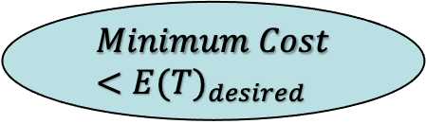

﻿Brute Force Solution
No disk
Disk 1
1,2
Disk 2
2,3
1,2
Disk 3
.
.
.
.
.
.
1,2,…,N
Disk N

Slide 24











﻿Greedy Solution
Disk 1
Disk 1
Result Set
Disk 2
Disk 2
.
.
.
Disk 3
Disk 3
.
.
.
.
.
.
Disk N
Disk N

Slide 25
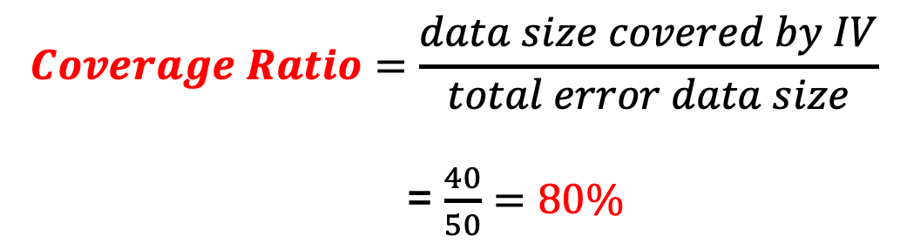

Evaluation Metrics
p=0.05
Memory
50 MB
p=0.02
10 MB
50 MB
10 MB
p=0.6
20 MB
20 MB
20 MB
p=0.9
20 MB

Slide 26
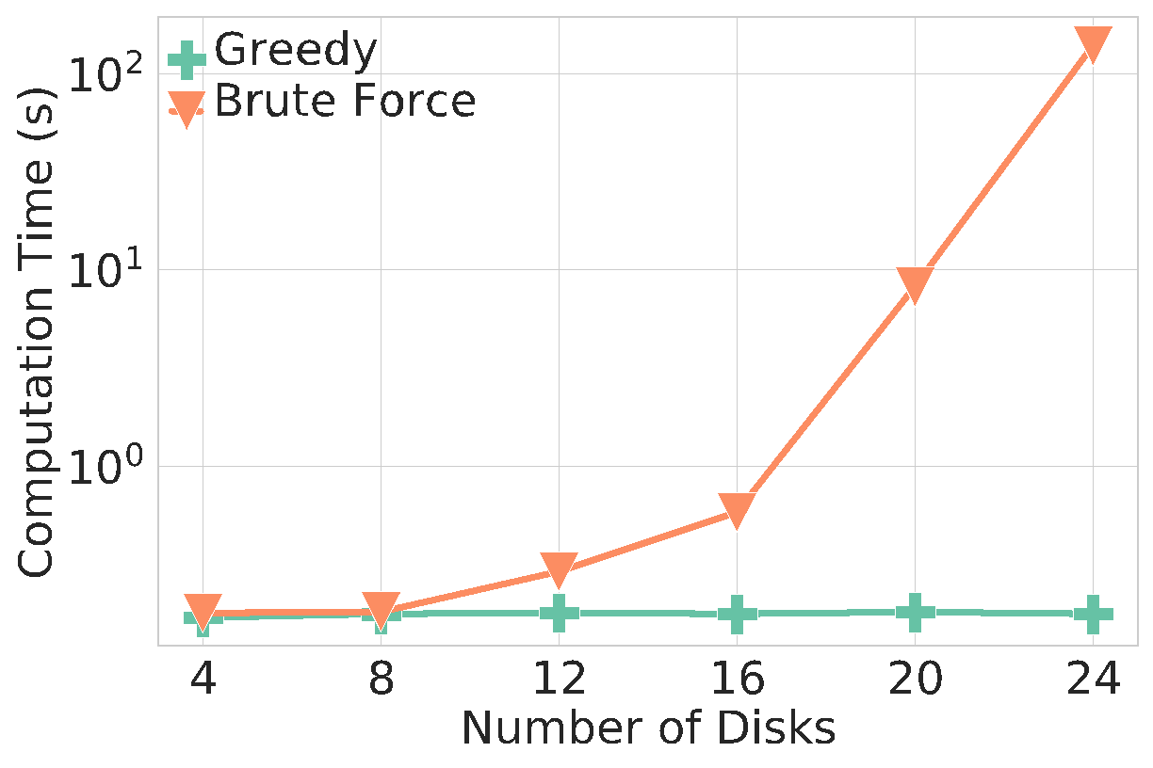
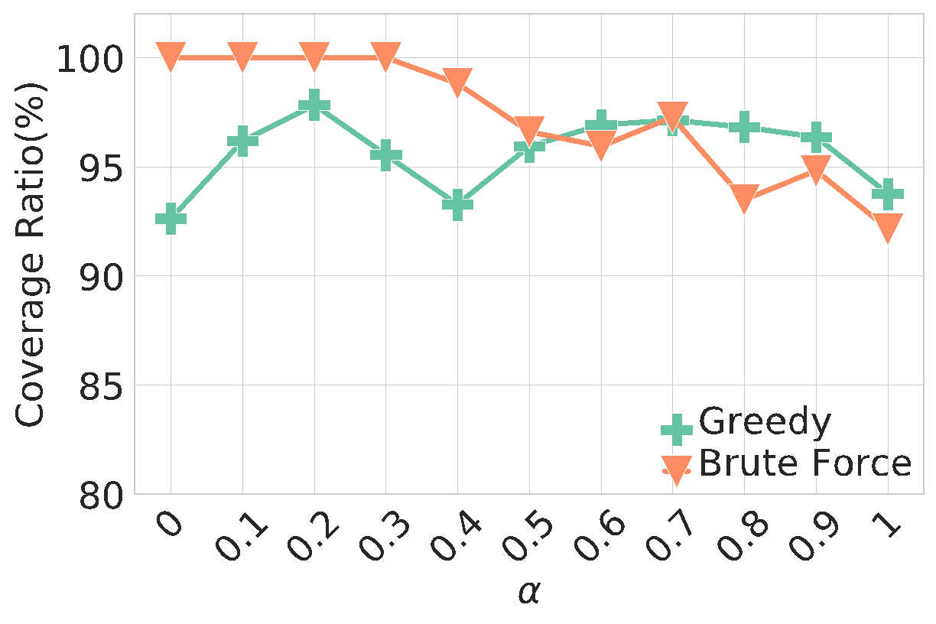
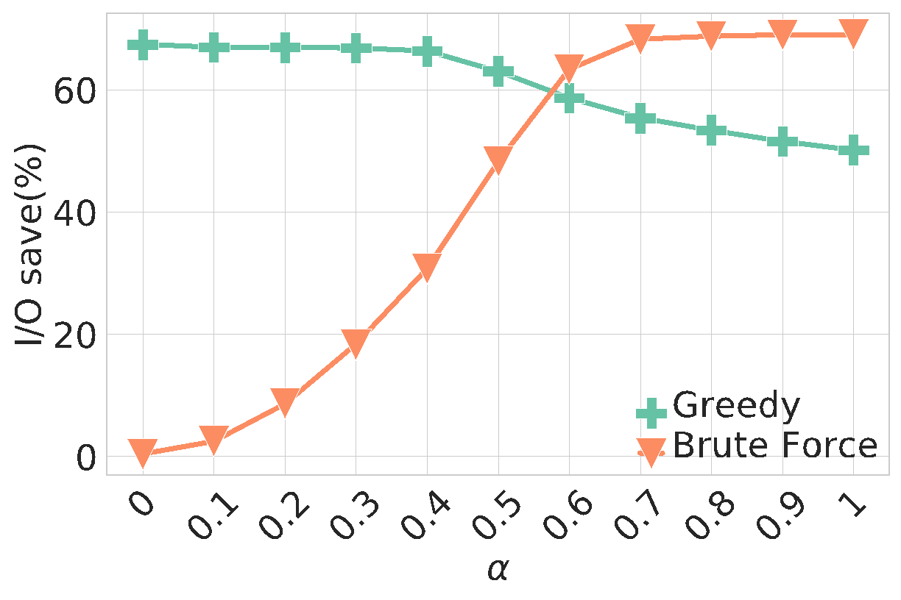
﻿Comparison of Brute Force and Greedy algorithms

Slide 27
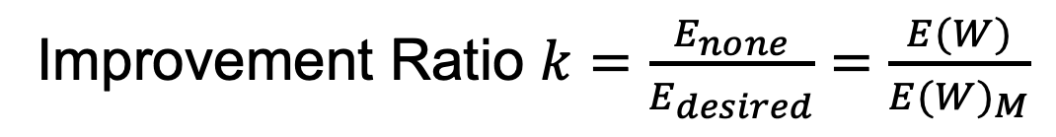
Improvement Ratio
Improvement Ratio $k=\frac{E_{none}}{E_{desired}}=\frac{E(W)}{{E(W)}_{M}}$
Large improvement ratio leads to an increase in the coverage ratio for all disk types.
Consequently I/O save ratio decreases.

Slide 28
Coverage Ratio Comparison
Batch Workload
Streaming Workload

Slide 29
I/O Overhead comparison
Batch Workload
Streaming Workload

Slide 30
Overhead Analysis on Production File Systems

Slide 31
Impact of probabilistic write verification
Darwin
Expanse
Expanse
Darwin
Campus Cluster
Stampede2

Slide 32
Conclusion
If not handled properly, ﻿uncorrectable errors can lead to complete data loss or even system failure.
We analyzed 270M SMART logs from 200K disks over a period of 93 months and developed prediction models for uncorrectable errors.
﻿Our models achieve up-to 98% accuracy in uncorrectable bit error prediction while keeping false positive rates less than 3%.

Slide 33

Conclusion
We incorporated the prediction model into two ﻿application scenarios.
Our probabilistic integrity verification method ﻿achieves up to 97% reduction in I/O overhead caused by the integrity verification process of wide area file transfers.

Slide 34
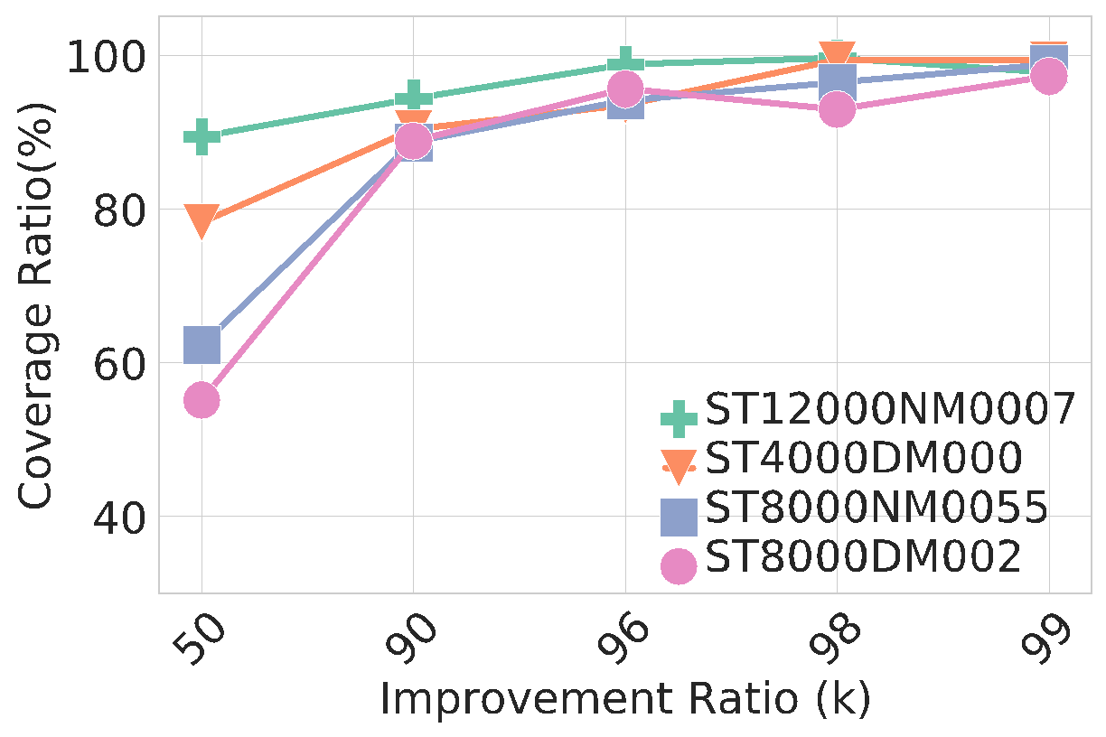

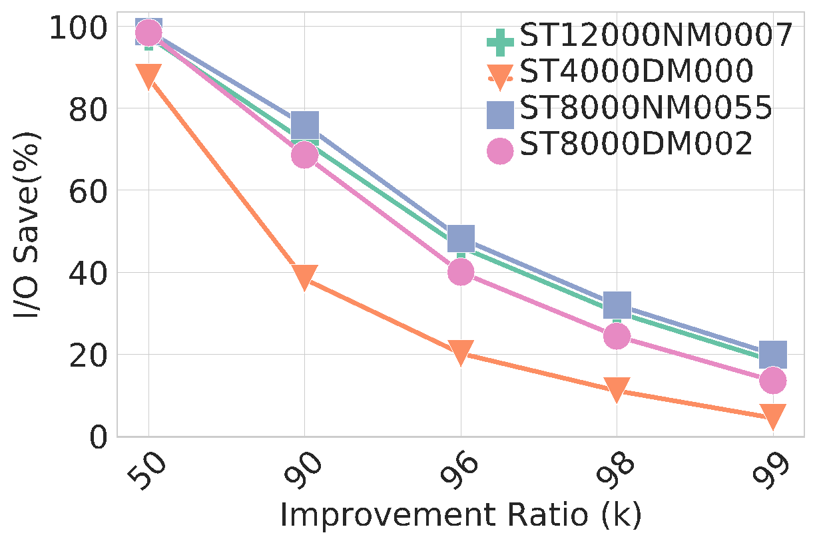
﻿Performance Analysis for Different Improvement Factors
Large improvement ratio leads to an increase in the coverage ratio for all disk types.
Consequently I/O save ratio decreases.
For 90% improvement ratio, we can achieve 85-95% coverage ratio while saving 40-75% I/O.

Slide 35
Impact of Probabilistic Integrity Verification on Transfer Time
 | I/O Saving Ratio
 | 0% | 10% | 50% | 90%
Time(sec) | ﻿360.8 ± 5.3 | ﻿353.6 ± 6.8 | ﻿263.0 ± 1.7 | ﻿168.5 ± 2.0
Transfer times is reduced by 53% for 90% I/O save

Slide 36
Avoiding Uncorrectable Errors through I/O Redirection

Slide 37

﻿I/O Redirection
Disk 1
p=0.1
Memory
Disk 2
p=0.2
Disk 3
p=0.6
Disk 4
p=0.9

Slide 38
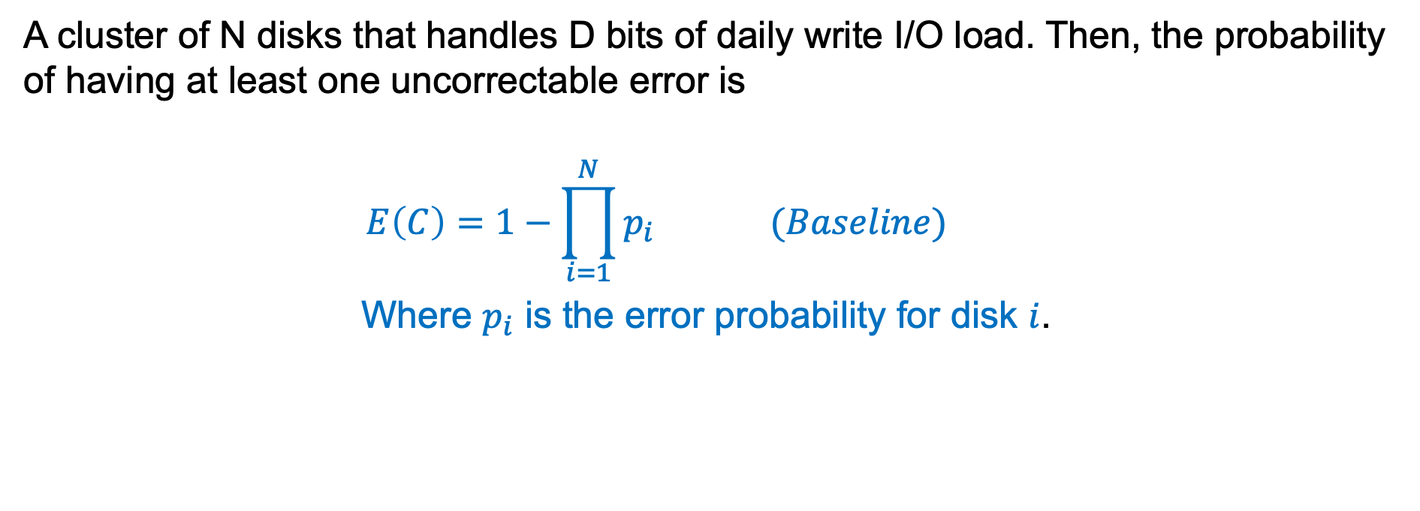
﻿Problem Definition

Slide 39

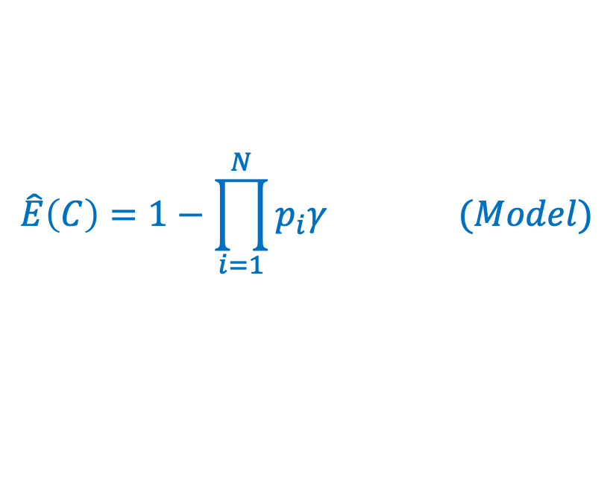
﻿Problem Definition
Let
𝛾 : increased error ratio for increasing I/O load
Then error probability will be

Slide 40


﻿I/O Redirection
Offline List
Offline List
Offline List
Offline List
Disk 1
Disk 1
Disk 1
p=0.6
Disk 2
Disk 2
Disk 2
p=0.9
Disk 3
Disk 3
Disk 3
p=0.1
.
.
.
.
.
.
Disk N
Disk N
Disk N
p=0.8

Slide 41


Evaluation Metrics
p=0.05
Memory
p=0.02
50 MB
50 MB
10 MB
10 MB
p=0.6
20 MB
20 MB
p=0.9

Slide 42
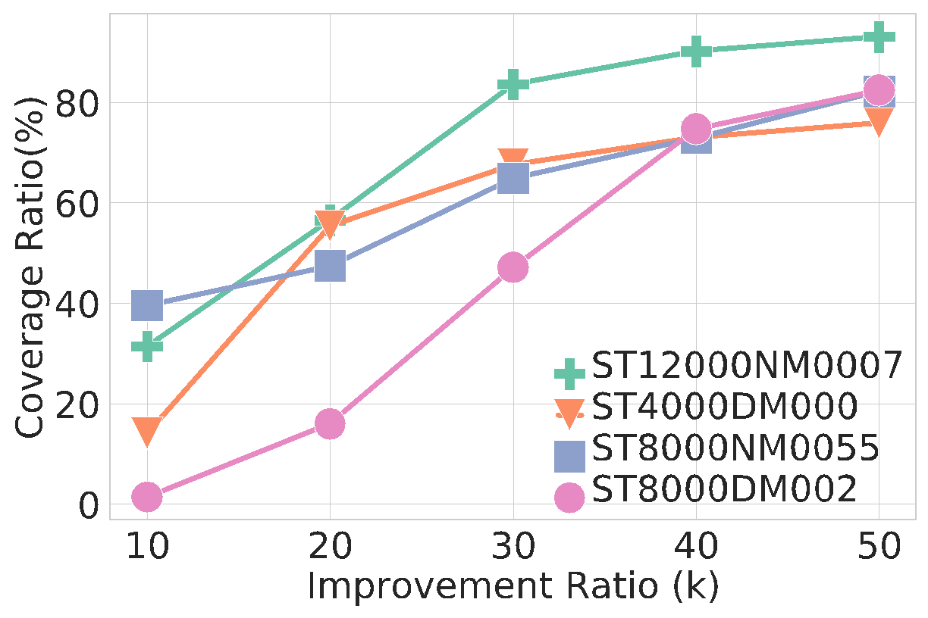
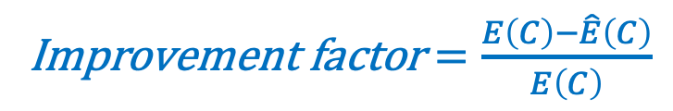
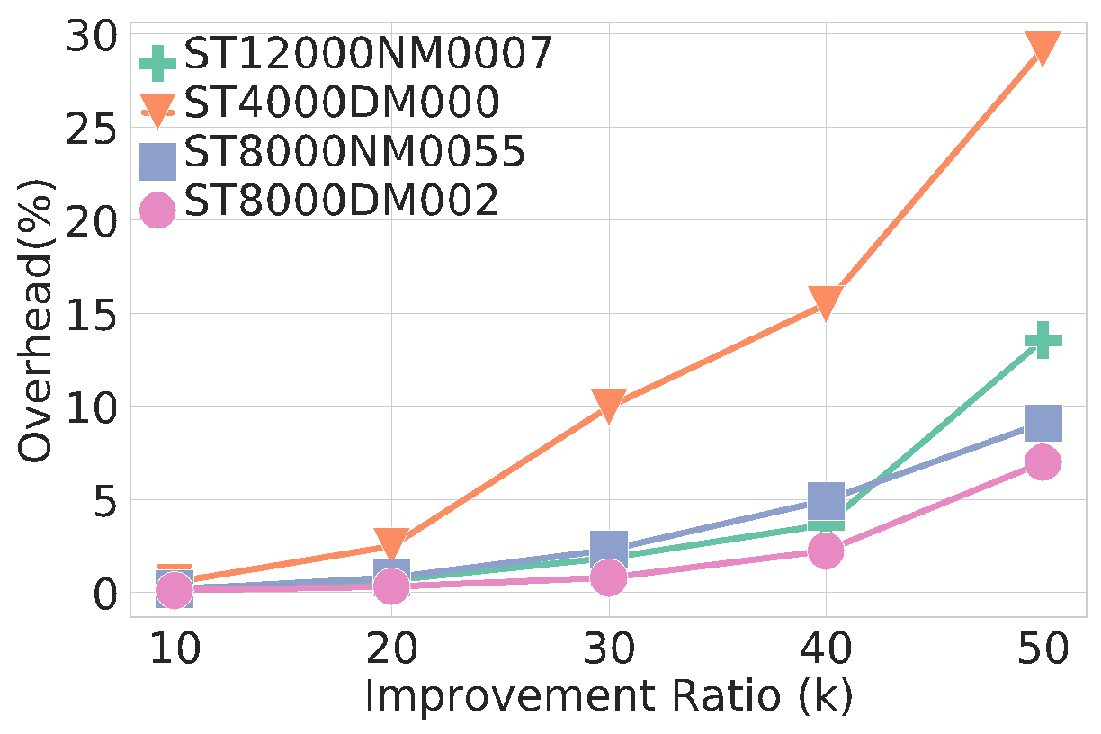
Performance Analysis of I/O Redirection
We can achieve more than 50% coverage ratio while keeping overhead less than 5%.
For disk model ST12000NM0007, we can even achieve 85-90% coverage ratio for less than 5% overhead.

Slide 43
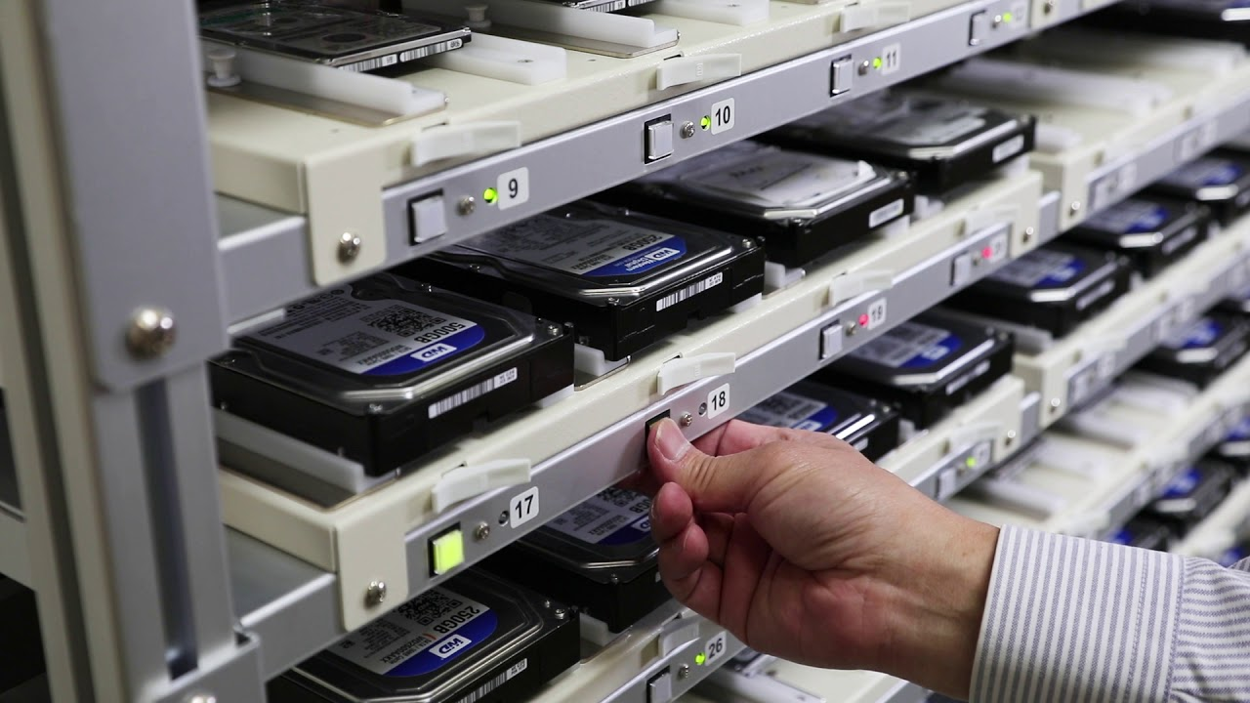
Scale is Increasing and So Does Failure
90% of the current datacenters are established after 2016.
Google uses more than 2.5 million custom servers that are equipped with multiple hard drives.
Facebook’s new data center has 500 racks that each hold 2 petabytes of data.
Notes:
Scale is increasing and so dos failure.

Slide 44
﻿Disk Models Used in This Work
﻿Disk mode | ﻿Capacity | Total Disk | Ratio of Disks with Uncorrectable Error
ST12000NM0007 | 12 TB | 38,272 | 2.2%
ST4000DM000 | 4 TB | 36,950 | 7.1%
ST8000NM0055 | 8 TB | 14,811 | 2.2%
ST8000DM002 | 8 TB | 10,161 | 2.7%
ST3000DM001 | 3 TB | 4,286 | 33.2%

Slide 45
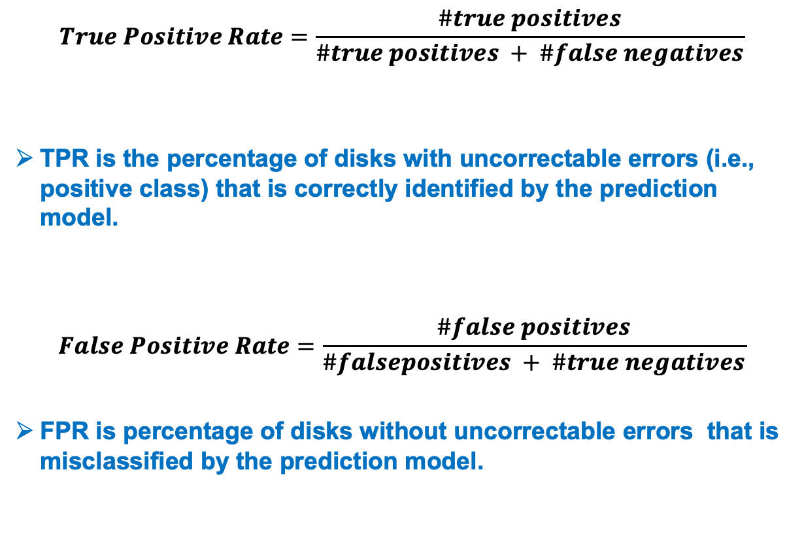
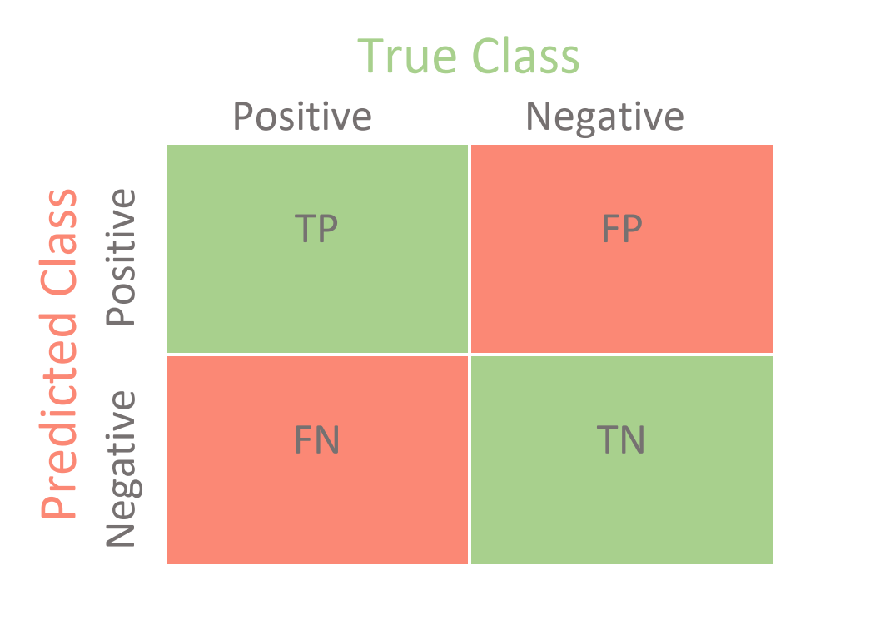
Evaluation Metrics

Slide 46
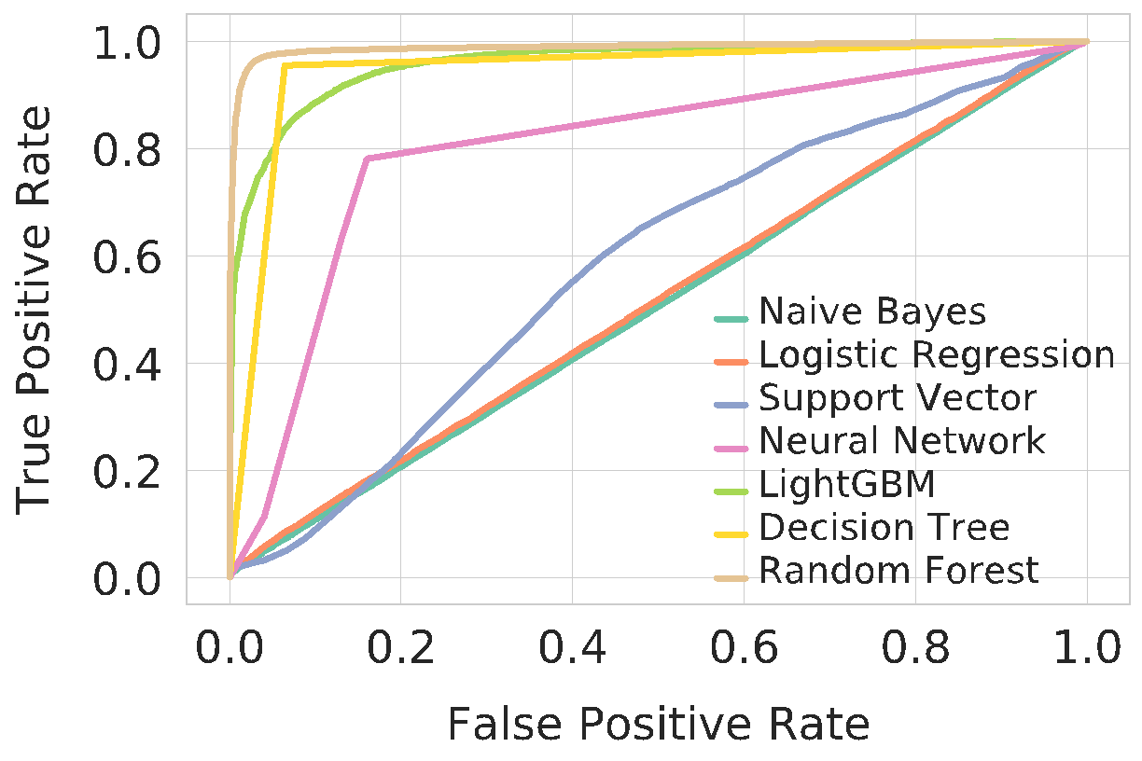
Model Evaluation
Random Forest achieves 97% TRP for less than 3% FPR

Slide 47
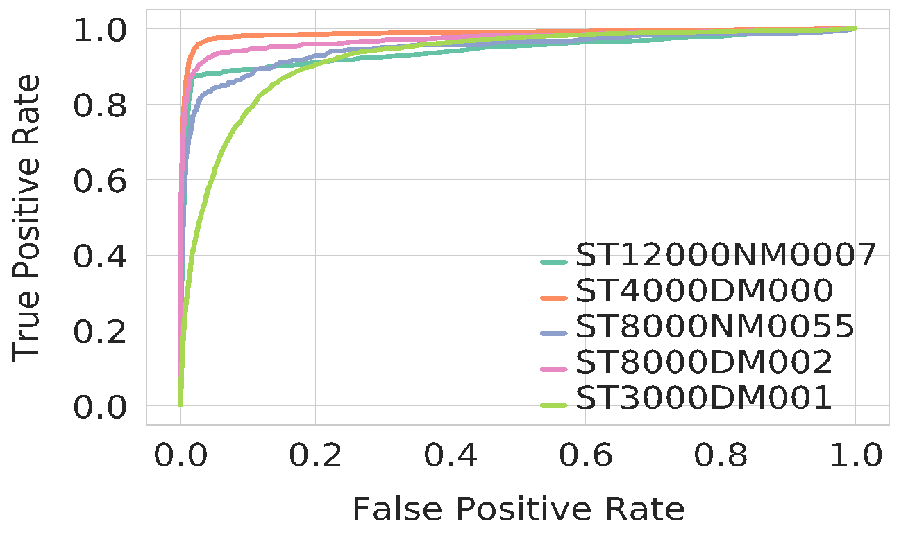
Performance Evaluation for Random Forest Classifier
﻿Random Forest achieves more than 95% TPR while keeping FPR less than 5% for ﻿ST12000NM007 and ST4000DM000.
﻿For ST80000NM0055 and ST80000DM002, 90% TPR causes less than or around 15% FPR.

Slide 48
Probabilistic Integrity Verification
Disk 1
p=0.1
Memory
Disk 2
p=0.2
Disk 3
p=0.6
Disk 4
p=0.9

Slide 49



Era of Big Data
Every minute on Facebook: 510K comments are posted, 293K statuses are updated, and 136K photos are uploaded. This generates about 500 TB of data each day.
Over 100 million Instagram posts are uploaded each day.
300 hours of video are uploaded to YouTube every minute.

Slide 50

﻿Problem Definition
Let
𝐸(𝑇) : Error probability without running integrity verification.

Slide 51

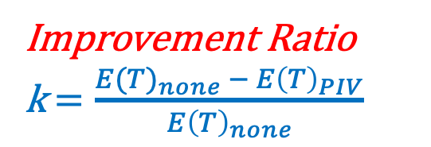
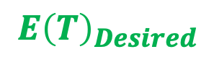
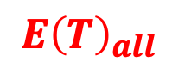
Probabilistic Integrity Verification
Disk 1
p=0.05
Memory
Disk 2
p=0.02
Disk 3
p=0.6
Disk 4
p=0.9

Slide 52
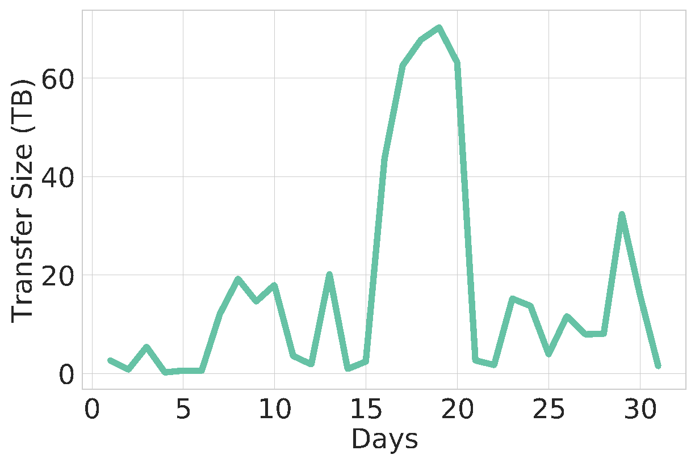
Additional I/O Size for End-to-End Integrity Verification​​​

Slide 54
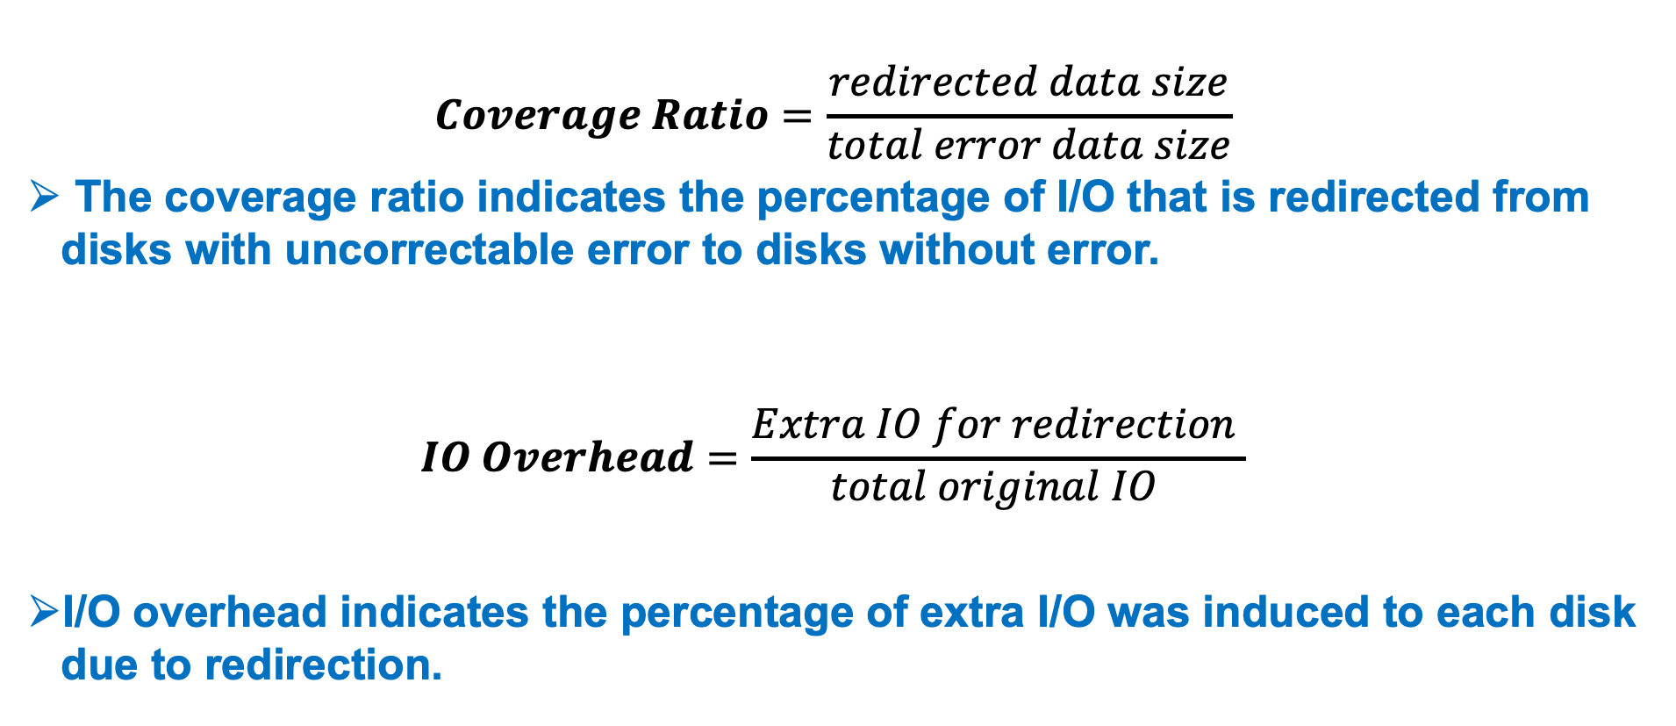
Evalution Metrics

Slide 55
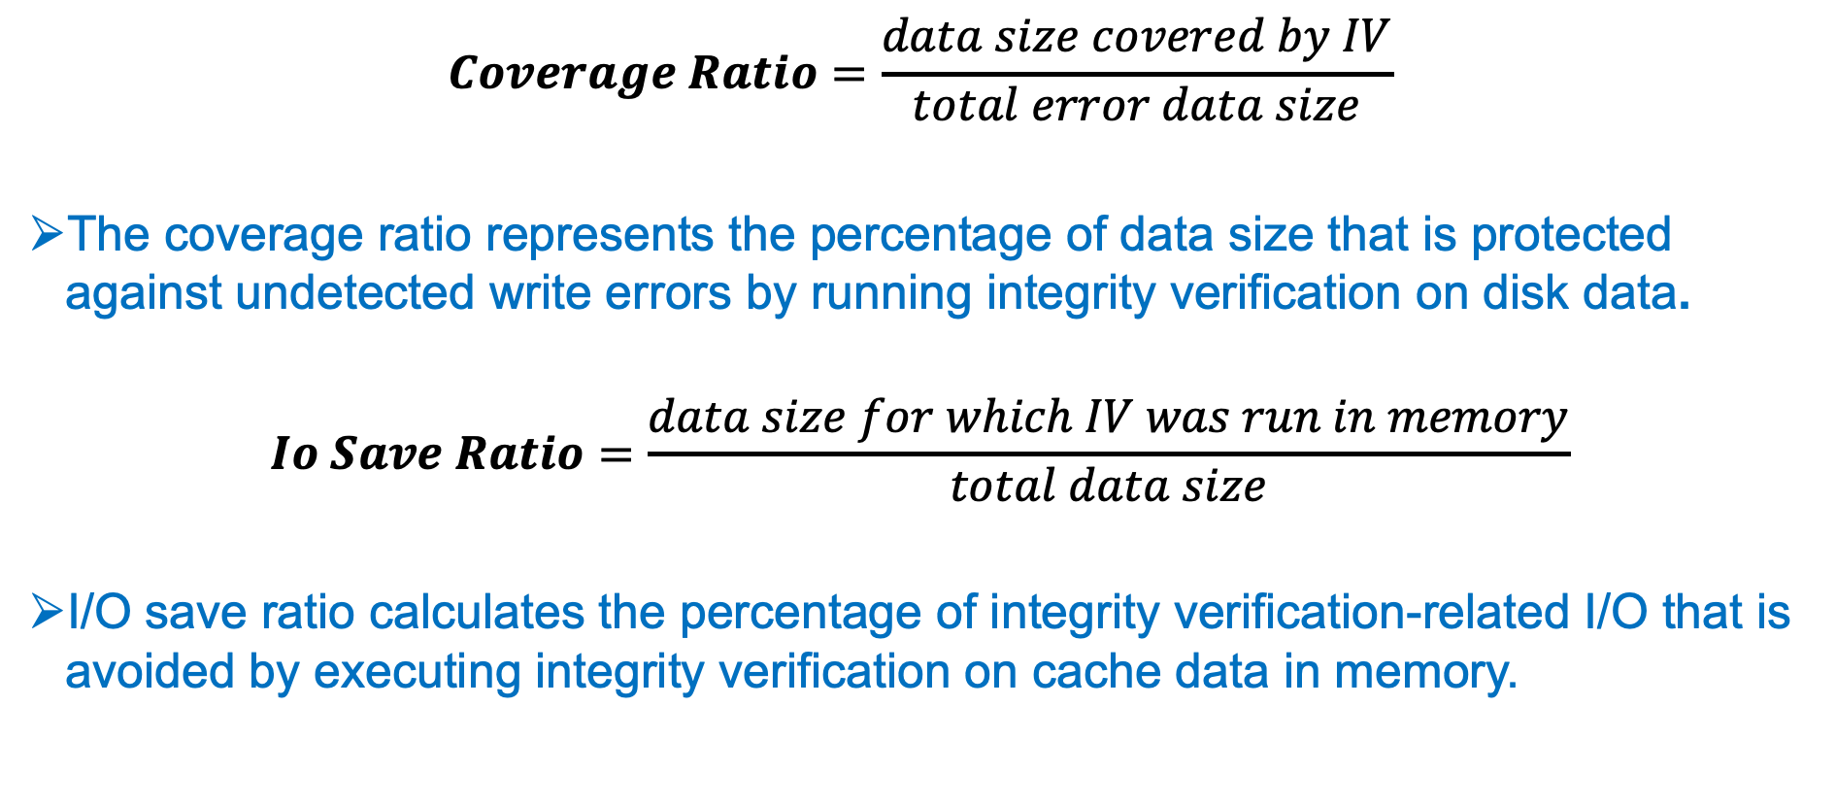
Evalution Metrics

Slide 56


Slide 57
﻿Comparison of Brute Force and Greedy algorithms

Slide 58
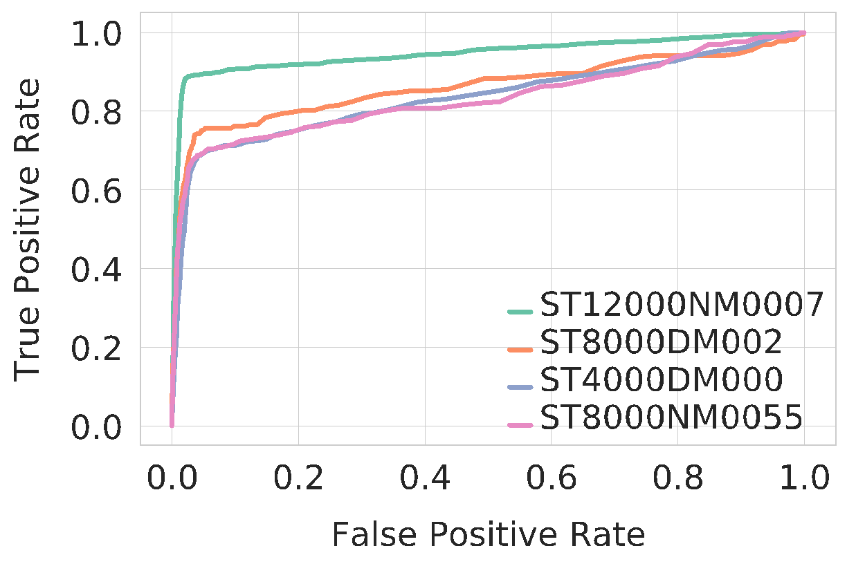
﻿Deployment Challenges and Opportunities
We developed our model using SMART metrics which is supported by all disk ﻿manufacturers.
﻿Storage footprint to store daily SMART logs is very negligible(32.5MB for 120k disks)
Transfer learning is challenging but our model can be used as a good starting point.
Both Raid arrays and Parallel File Systems have options to deactivate disks.

Slide 59
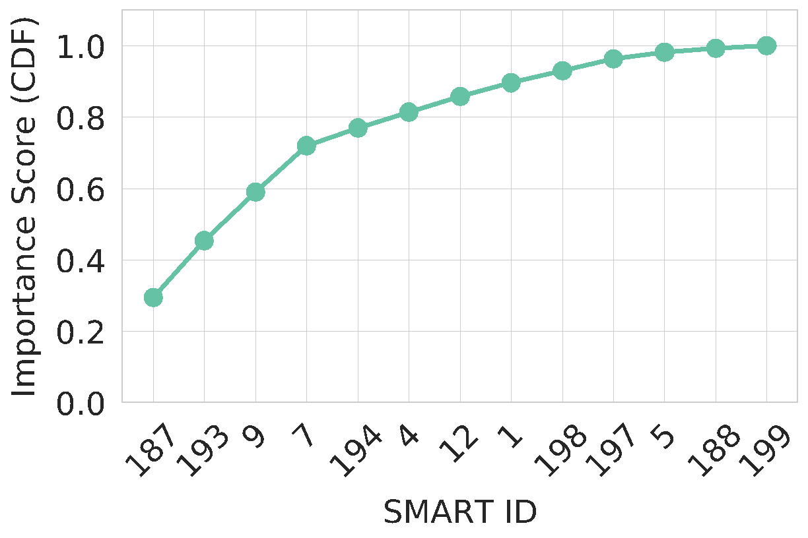
Feature Selection

Slide 60
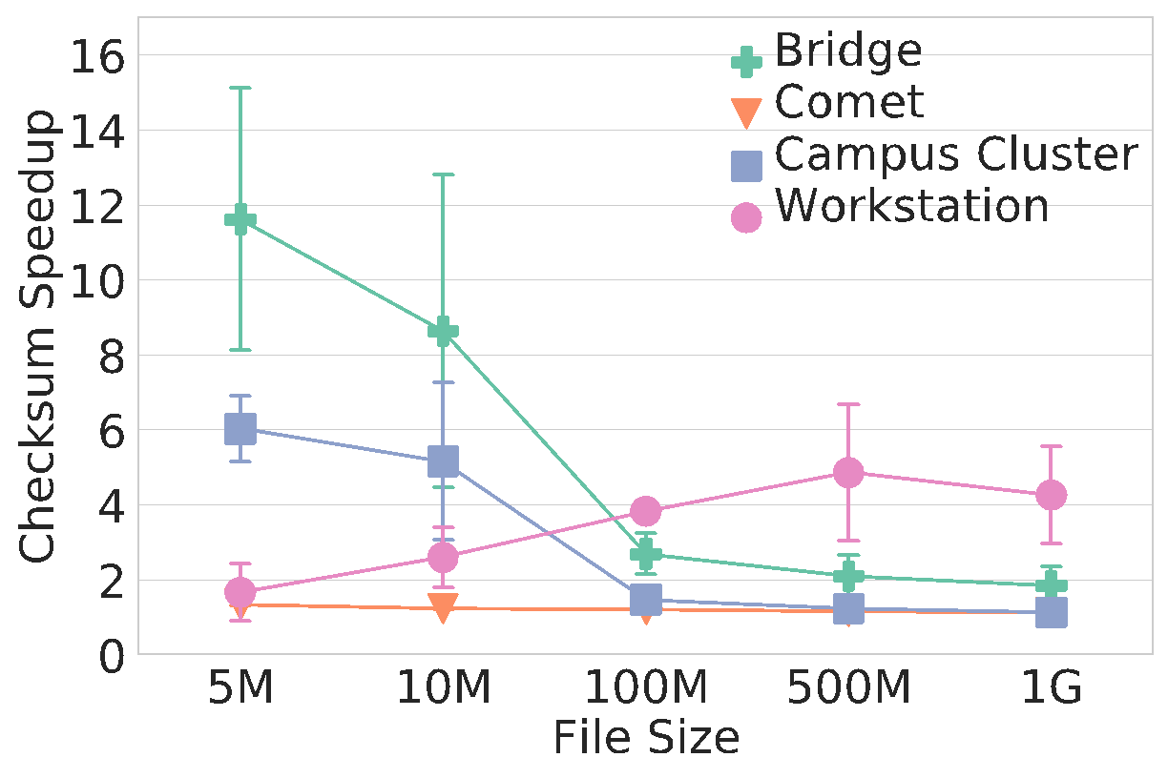
Checksum Calculation Speedup Ratio

Slide 61
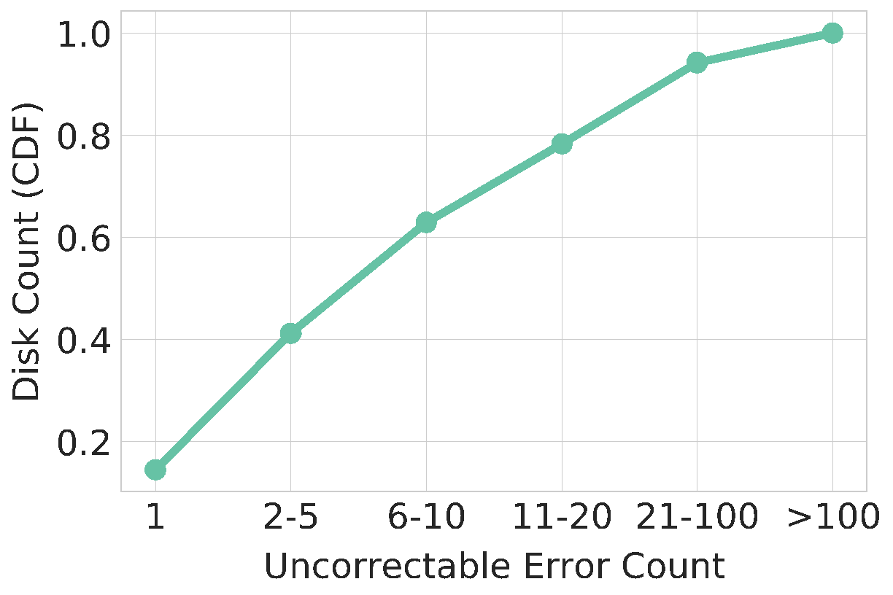
Dataset Charactaristics
﻿14.5% of disks raised only one error.
﻿21.7% of disks raised more than 20 uncorrectable errors.
﻿6% disks had more than 100 errors.

Slide 62
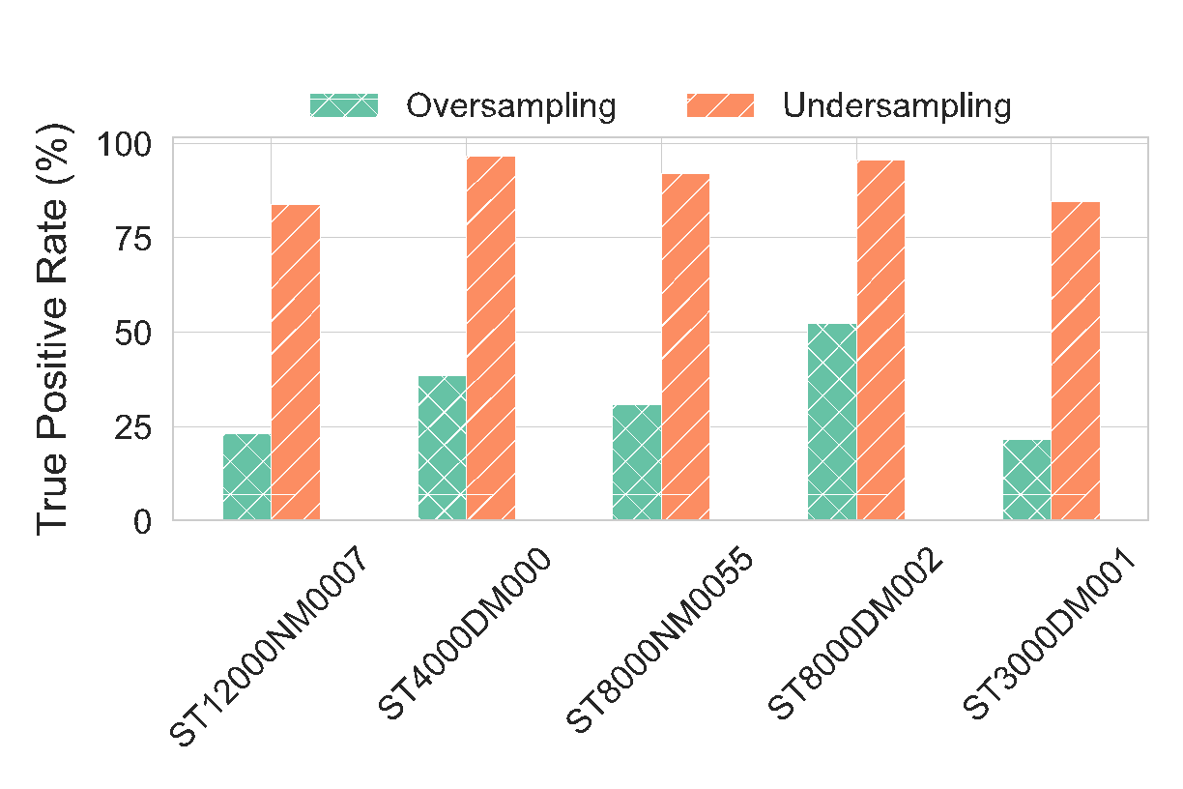
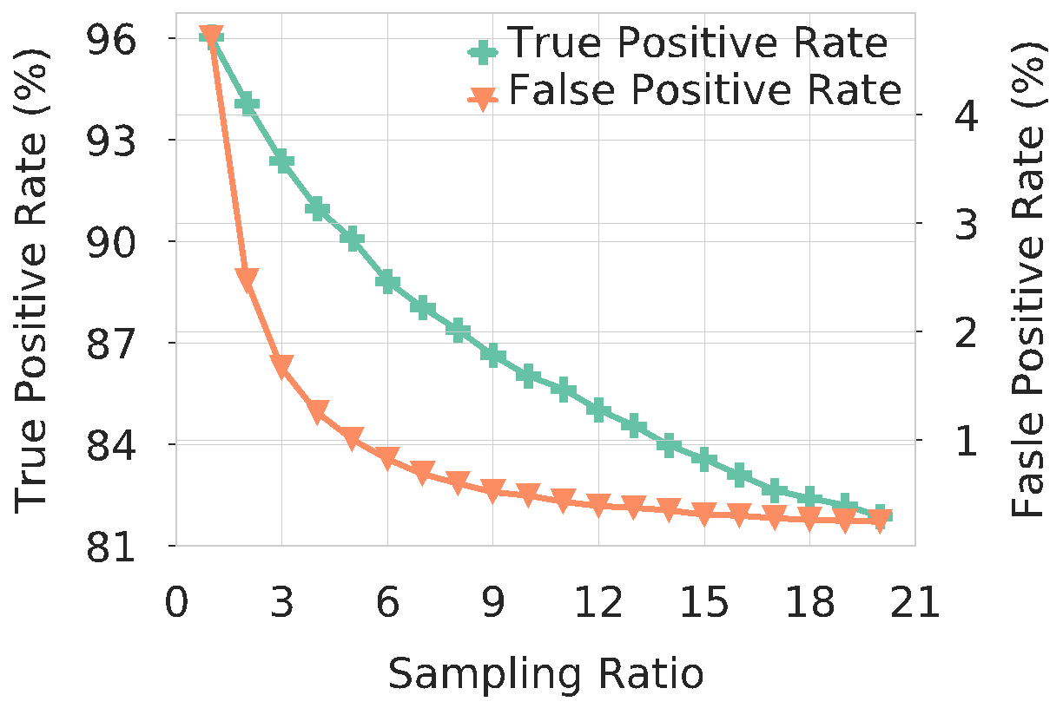
Handling Data imbalance

Slide 63
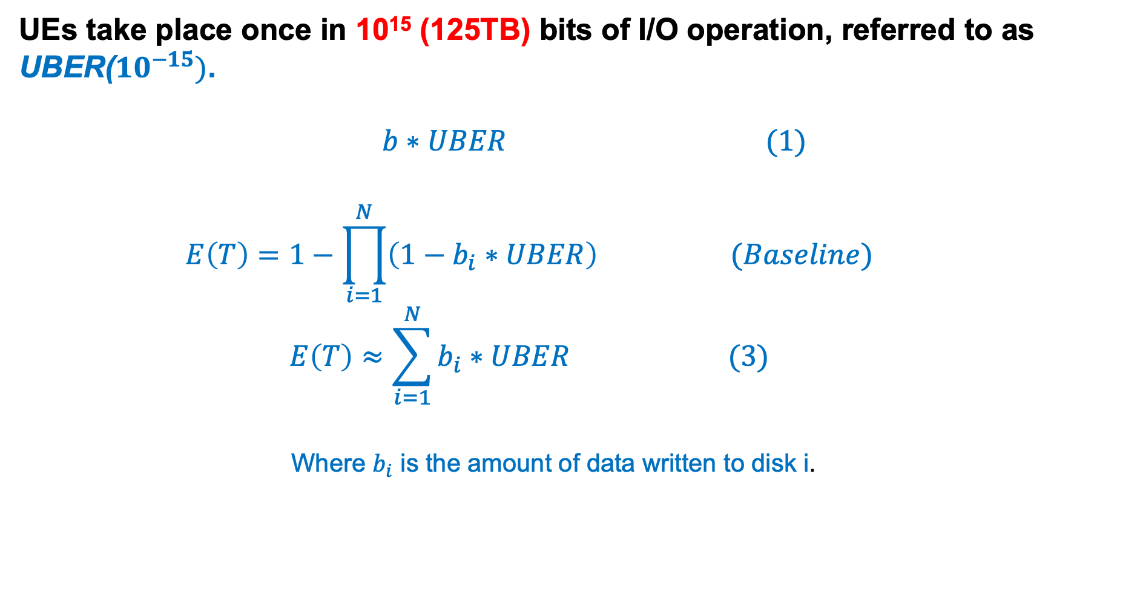
﻿Problem Definition

Slide 64
Simulation Default Settings
We simulated our algorithm on BackBlaze SMART logs.
﻿RAID level ->0﻿(no parity or mirroring)
﻿Number of disks in RAID array -> 8
Stripe Size -> 128KB
Stripe Count -> 1
﻿the number of disks used for each file transfer -> 8
﻿Improvement ratio, k -> 90% (10 times improvement)

Slide 65
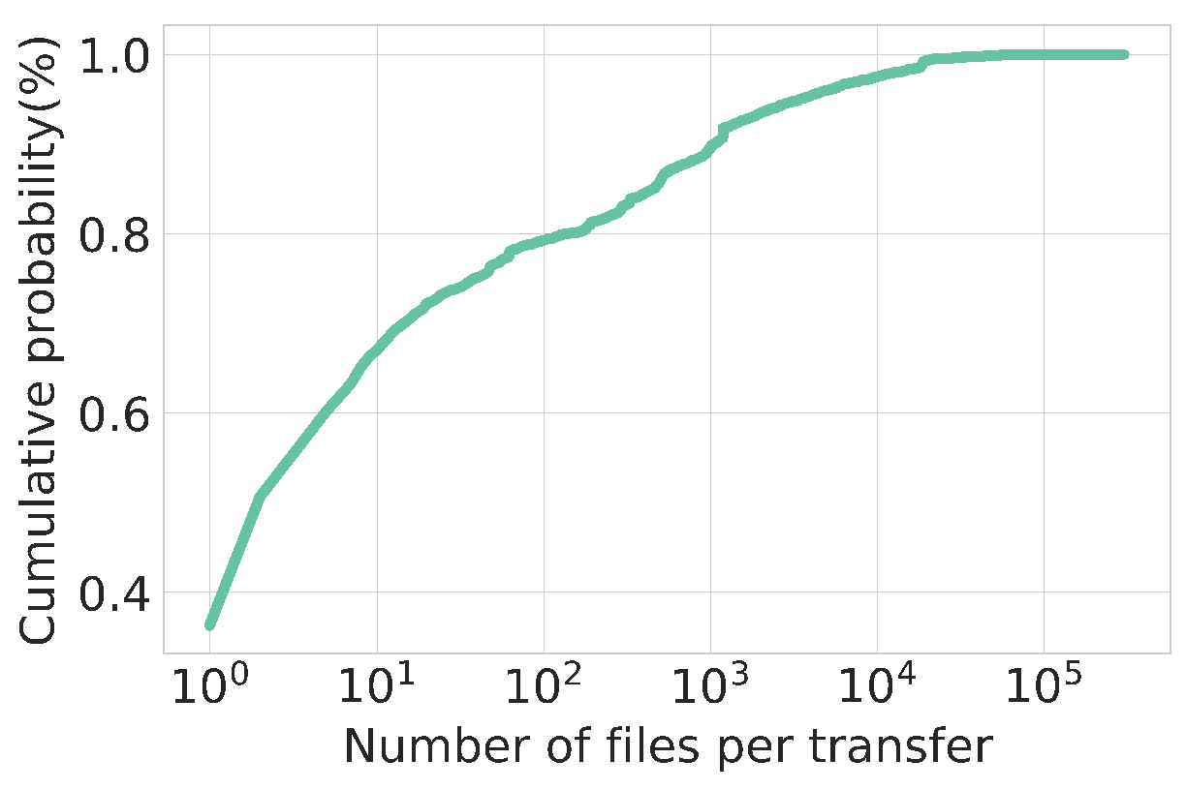
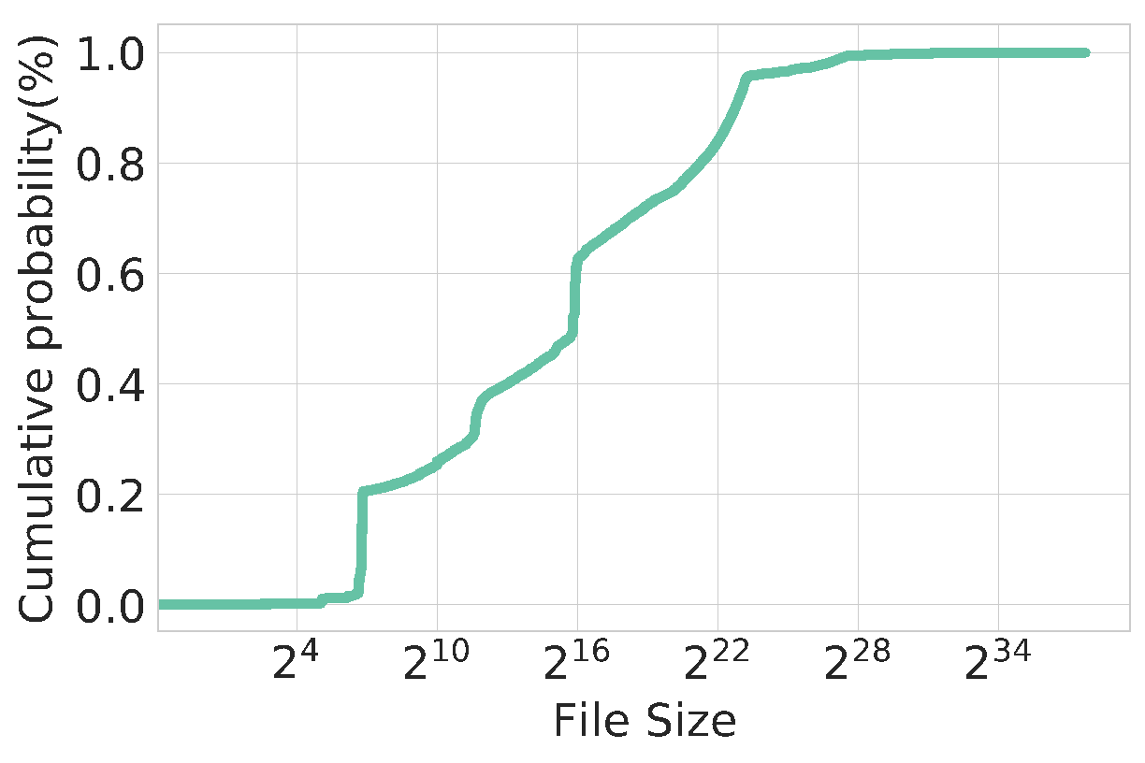
Dataset Characteristics

Slide 66
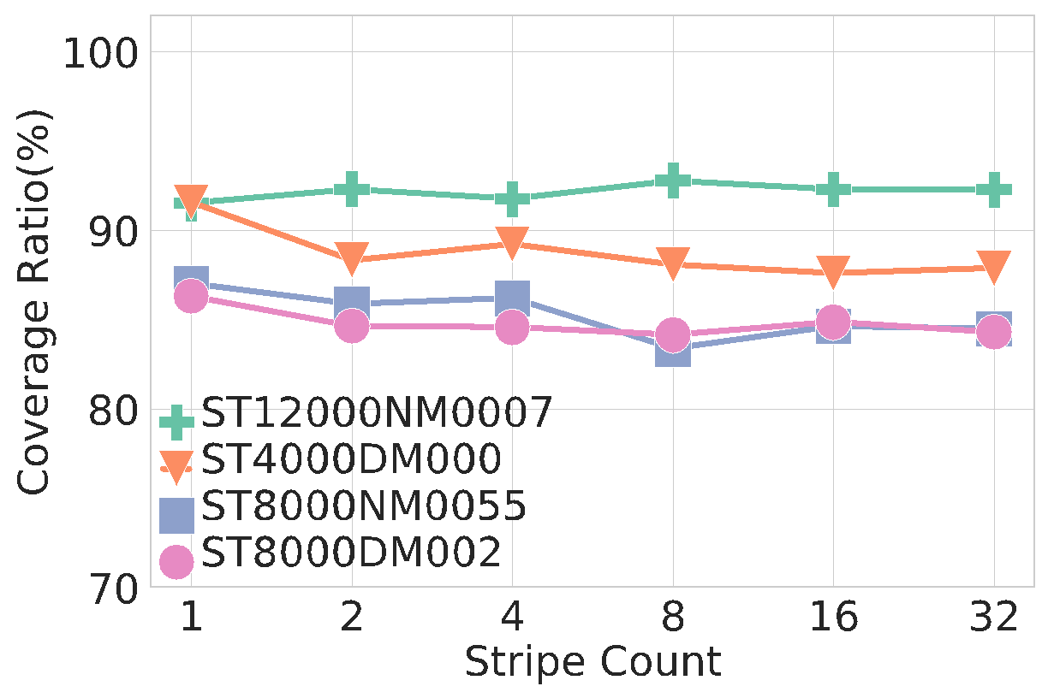
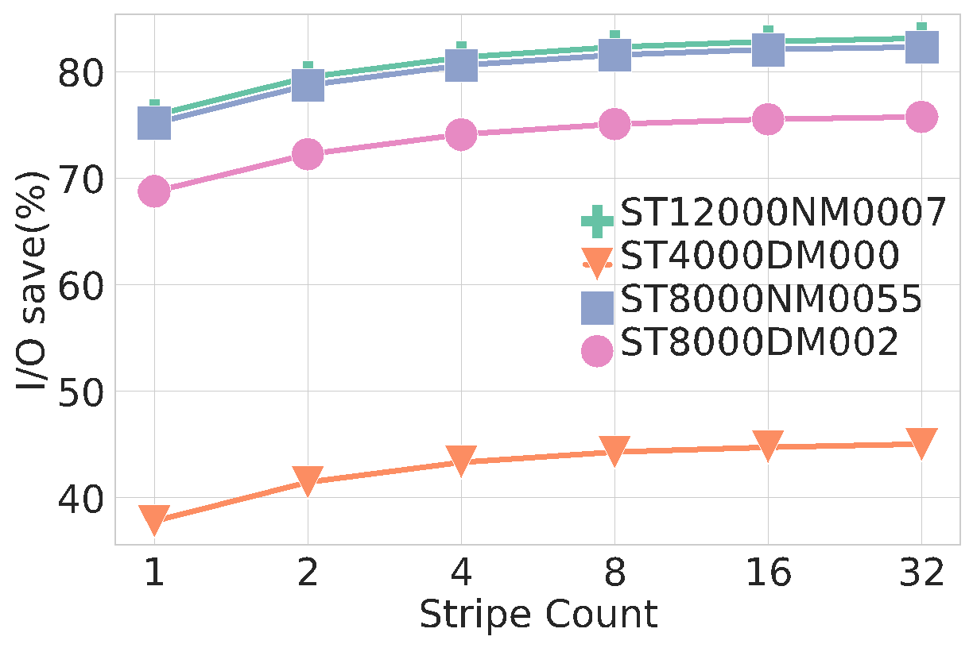
Performance Analysis for different Stripe Count

Slide 67
﻿I/O Redirection
Offline List
Offline List
Offline List
Offline List
Disk 1
Disk 1
Disk 1
p=0.6
Disk 2
Disk 2
Disk 2
p=0.9
Disk 3
Disk 3
Disk 3
p=0.1
.
.
.
.
.
.
Disk N
Disk N
Disk N
p=0.8

